Slide 1
Real Time Emotion Recognition from text using Deep learning and Feedback Analysis
Submitted by
Team Members
Atul Kumar Nayak 20R21A6603
A. Rohan 20R21A6604
G. Kausthub 20R21A6617
K. Midhilesh 20R21A6626
Under the Guidance of
G. Sowmya
Assistant professor

Slide 2
CONTENTS
ABSTRACT
01
INTRODUCTION
02
OBJECTIVES
03
EXISTING SYSTEM
04
PROPOSED SYSTEM
04
05
RESULTS
06
FUTURE ENHANCEMENTS
CONCLUSION

Slide 3
ABSTRACT
In the era of digital communication, understanding human emotions expressed through text has become increasingly vital, this increases the importance of accurate emotion recognition from text,which can be useful in various applications. This project delves into the realm of text-based emotion recognition precisely identifying and categorizing the emotions expressed in textual content by using a deep learning approach such as Bi-LSTM. Presently, a significant portion of ongoing research primarily centers on the classification of text based on sentiments, with a small fraction focusing towards emotion recognition, particularly within the context of business applications. The principal objective of our project is to bridge the gap between the business organizations and the customers by analyzing the customer reviews based on emotion classification. This helps furnish organizations with a systematic approach to comprehend customer emotions, providing a more precise evaluation of product performance.

Slide 4
INTRODUCTION
Emotion recognition from text is the task of identifying the emotions expressed in a piece of text.
Emotion detection emerges as a specific component, focusing not solely on categorizing sentiments as positive, negative, or neutral, but rather on predicting distinct emotional states.
Deep learning approach has been shown to be effective for emotion detection from text.
This system will help businesses gain deeper insights into customer sentiments and make informed decisions to enhance customer satisfaction.

Slide 5
OBJECTIVES
● Creating a hassle free user experience front end.
● Storing the customer information in the database for data analysis purpose.
● Using Deep Learning model known as Bi-LSTM to find the emotion of the review.
● Creating an alerting module for the customer care to look into the customer dissatisfaction
● Automated reply to the customer.
● Data Analysis based on product, location, age group and gender.

Slide 6
EXISTING SYSTEM
There are some of the existing systems that rely on approaches like Keyword-Based, Rule-Based, SVM and Lexical Affinity.
Many early emotion detection systems relied on keyword-based approaches, where certain words or phrases were associated with specific emotions.
Rule-based systems involve creating complex sets of rules to determine emotions based on linguistic patterns.
The SVM can be used to detect emotions from text by finding the hyperplane that best separates the data points into different emotions.
Lexical affinity models rely solely on the presence of emotion-related words in text.

Slide 7
DISADVANTAGES
Disparity between theoretical developments and practical applications in customer feedback analysis and emotion recognition.
Falls short in capturing complex emotions.
Inadequate data visualization and unreliable data analysis of the gathered customer feedback.
Lack of prompt response to customer complaints leading to dissatisfaction.
Misclassifications are high.

Slide 8
LITERATURE SURVEY
● A detailed study helped in exploring various methods for detecting emotion in text such as machine learning, natural language processing, deep learning, and newer models.
● The main problem arises is that, some of these methods require a lot of computational power,and others may not be very accurate.
● These are some important insights that we gained after performing the literature survey:
●Learned the importance of the proper balanced datasets
● Found different problems which can arise during preprocessing
●Found about different embedding techniques
● Taken inspiration for visualizing data

Slide 9
PROPOSED SYSTEM
The proposed system introduces an advanced solution for emotion recognition from text by leveraging the deep learning methods
The Emotions are often conveyed through the sequence of words in a sentence.Long Short-Term Memory networks are designed to handle sequential data, making them effective for capturing the emotional progression in text
Our project identifies the emotion of customer feedback and based on the emotion it generates an automated email. By analysing all the customer feedbacks it generates a emotional tailored mail to the customer and along with owner of the organization can analyze the data based on various scenarios.

Slide 10
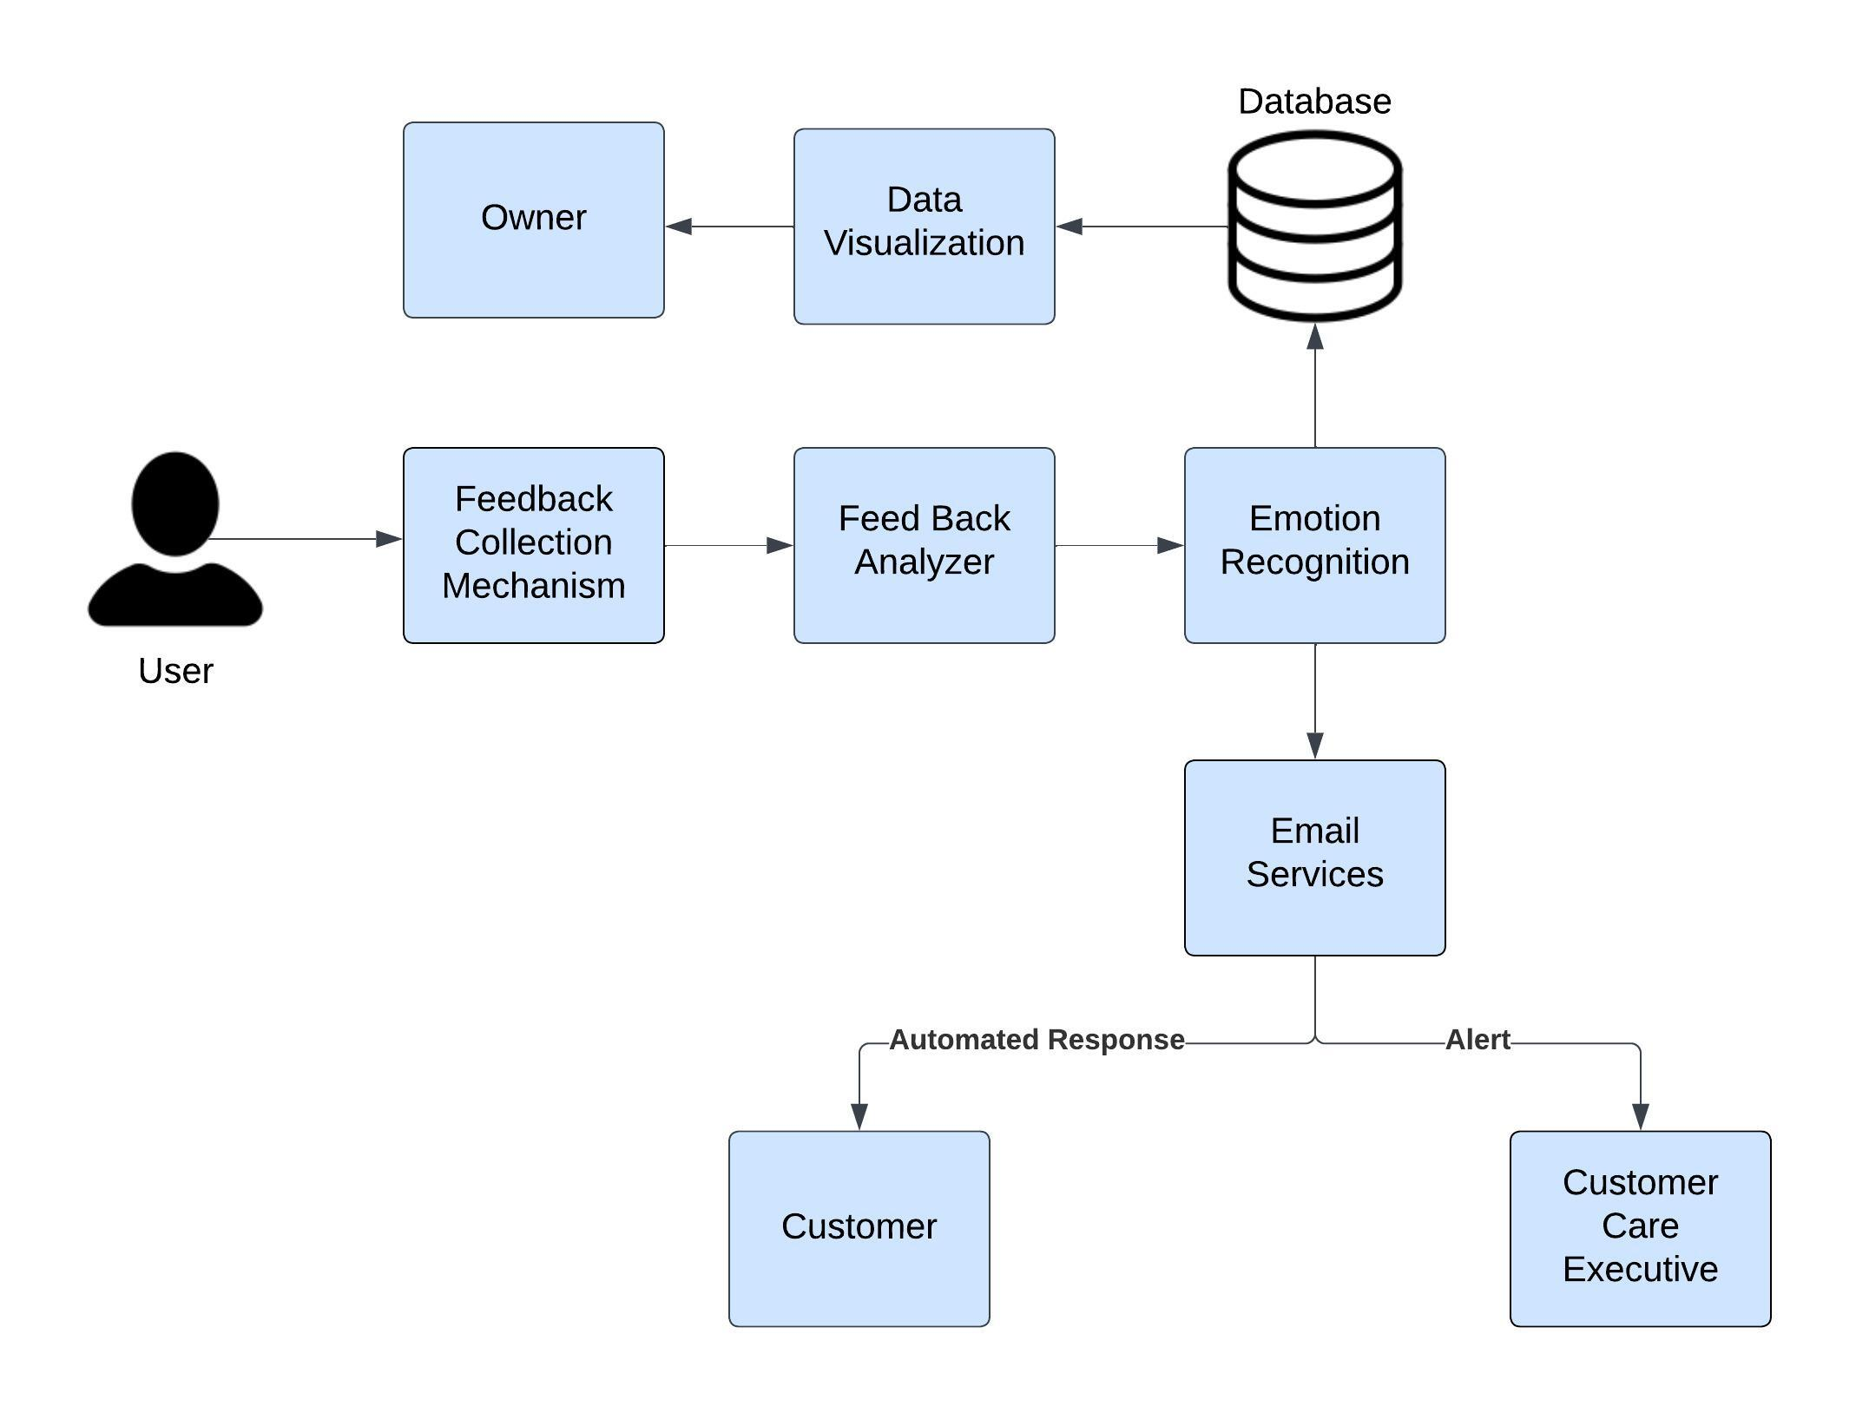
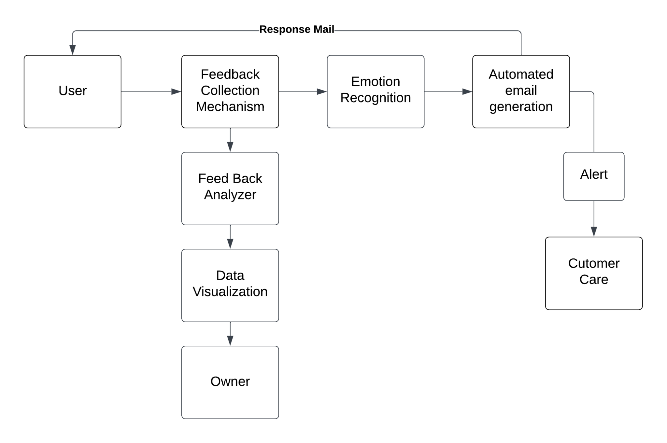
ARCHITECTURE

Slide 11
ADVANTAGES OF PROPOSED SYSTEM
Accurate emotion analysis enables deeper insights into customer preferences, concerns, and sentiments.
Real-time emotion recognition allows for personalized and targeted responses to customer feedback, enhancing satisfaction and loyalty.
Automated emotion recognition optimizes customer care allocation for prompt issue resolution.
Organizations can identify trends, patterns, and areas for improvement, leading to enhancements in products and services.

Slide 12
SOFTWARE REQUIREMENTS
● Based on the code files provided, here are the software requirements for this project:
1. Editor for HTML, CSS, Python, Flask, Streamlit - VS Code
2. Google Chrome, Firefox, Microsoft Edge or Brave Browser for feedback form, business owner dashboard and managers portal.
3. Google collab and kaggle notebooks for training.
4. Programming Language: Python
5. Python Libraries and Frameworks:
Flask (for building the web application)
Keras/TensorFlow (for building and training the machine learning model)
Pandas (for data manipulation and analysis)

Slide 13
SOFTWARE REQUIREMENTS
NLTK (Natural Language Toolkit for text preprocessing)
smtplib (for sending emails via SMTP)
Streamlit (for building the data visualization dashboard)
6. Word Embeddings:
GloVe pre-trained word embeddings (for representing text data numerically)
7. Database:
MySQL (for storing customer information, orders, and feedback data)
8. Email Server:
Access to an SMTP server (e.g., Gmail) for sending emails

Slide 14
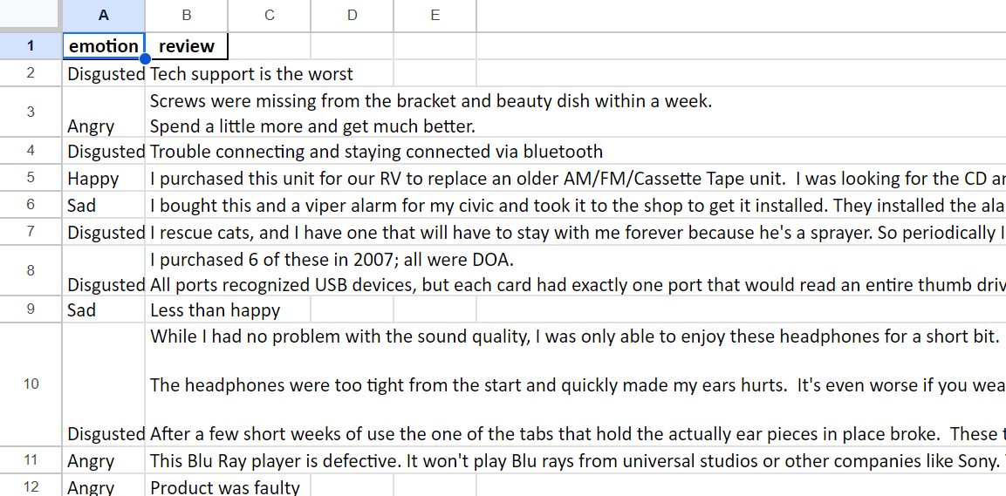
DATASET
https://docs.google.com/spreadsheets/d/1PW-C-fL-ozzDETkStvL4Adv-KMIaWeC9fGq_kX9OJRw/edit?usp=sharing

Slide 15
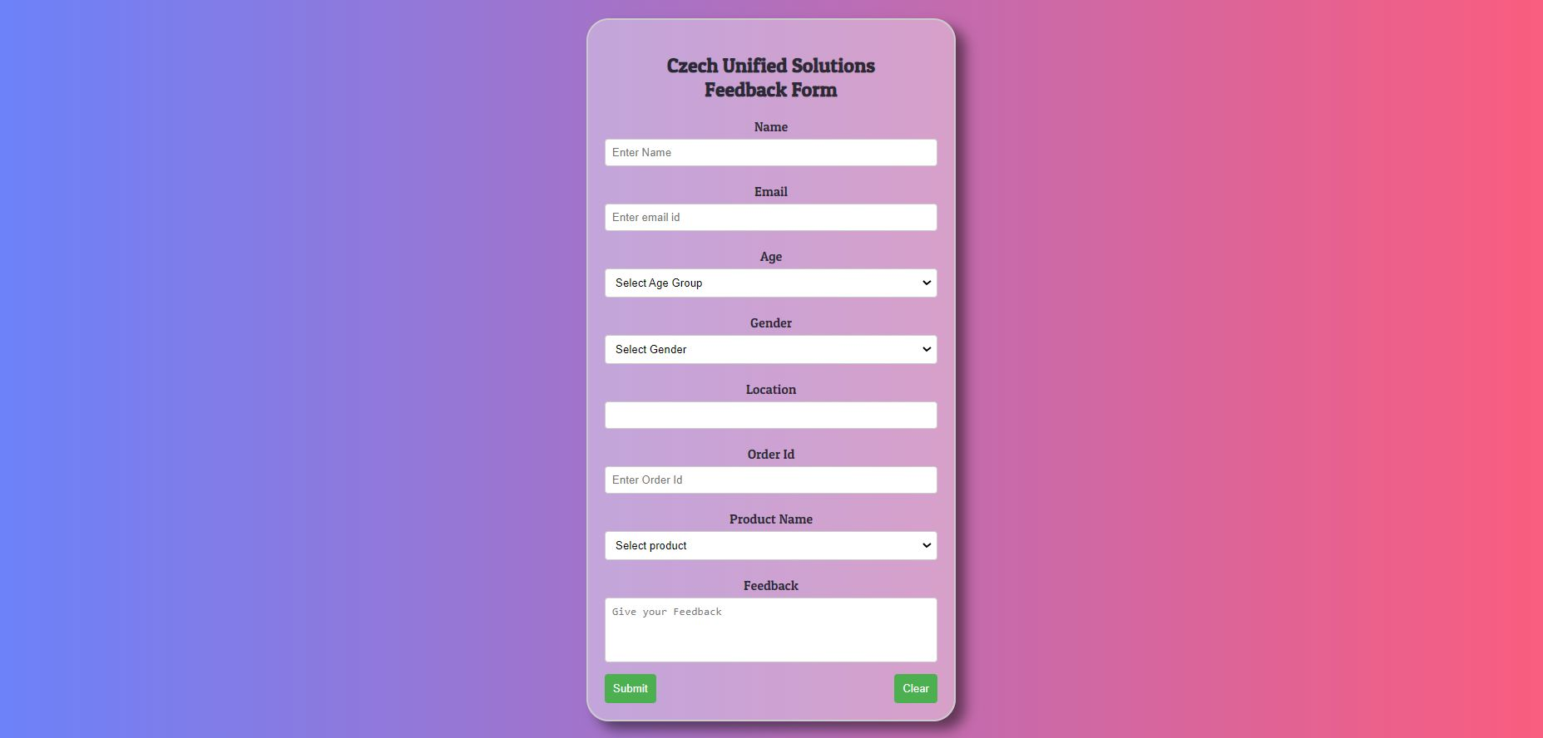
RESULT - Feedback Form
NLTK (Natural Language Toolkit for text preprocessing)
smtplib (for sending emails via SMTP)
Streamlit (for building the data visualization dashboard)
6. Word Embeddings:
GloVe pre-trained word embeddings (for representing text data numerically)
7. Database:
MySQL (for storing customer information, orders, and feedback data)
8. Email Server:
Access to an SMTP server (e.g., Gmail) for sending emails

Slide 16
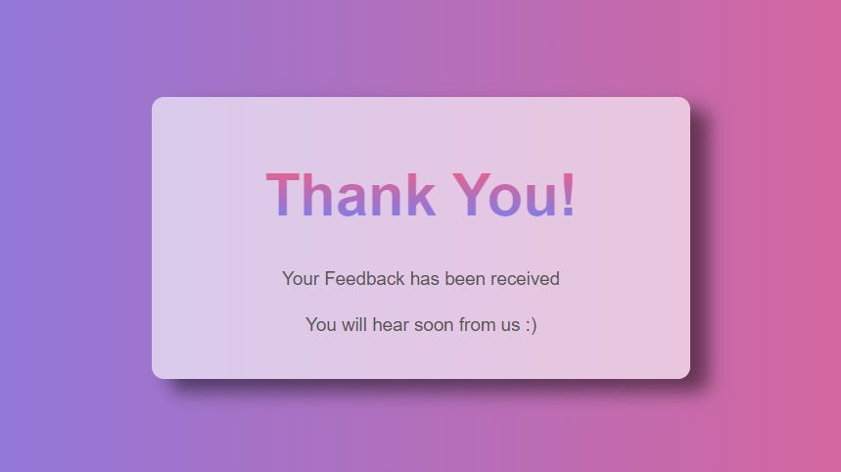
RESULT - Feedback Submission Confirmation

Slide 17

RESULT - Order Not Found Scenario

Slide 18
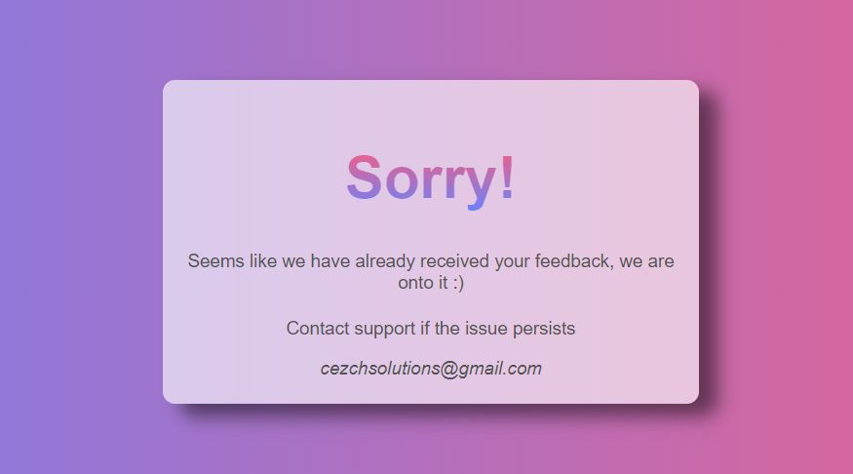
RESULT - Re-Entering Feedback Scenario

Slide 19
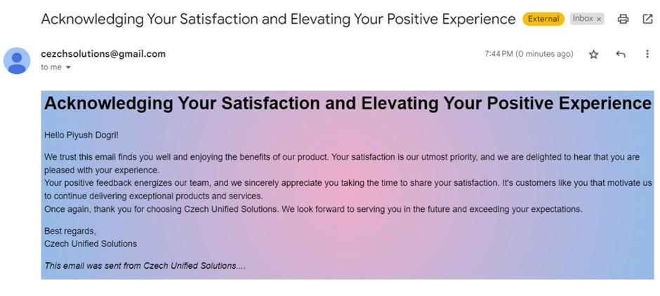
RESULT - Automated Response To Customer

Slide 20
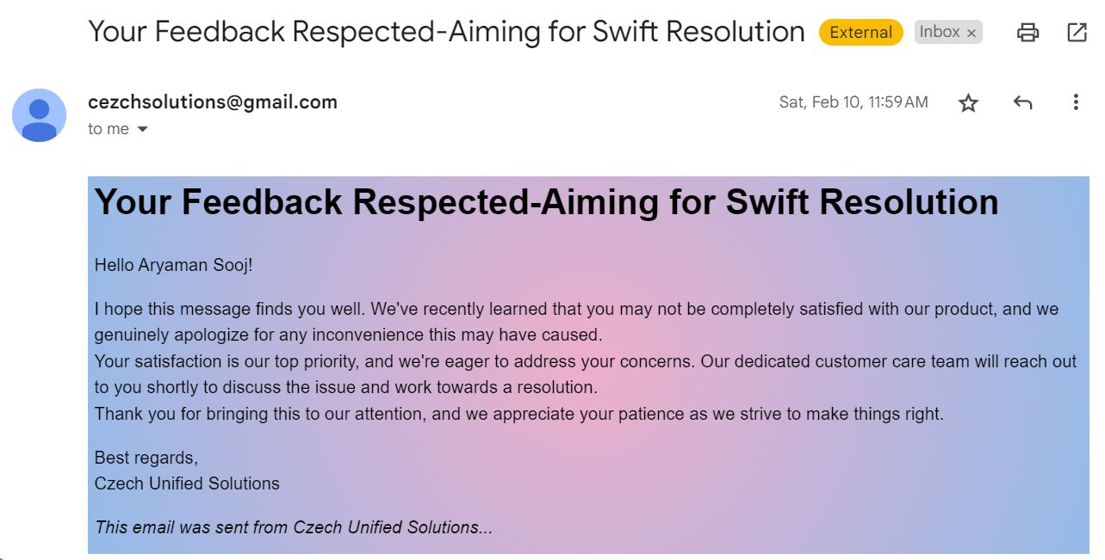
RESULT -Automated Response to customer

Slide 21
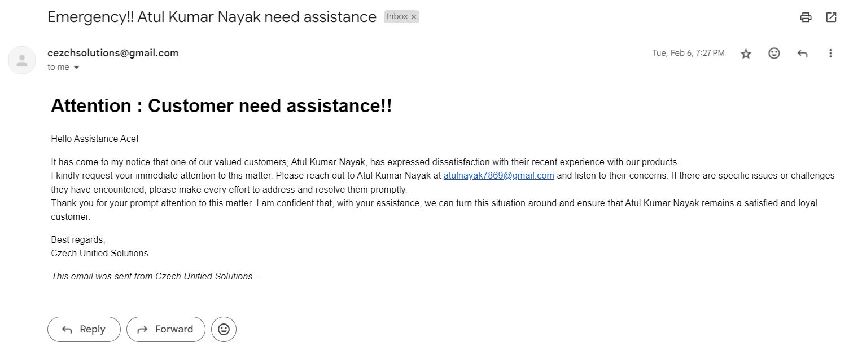
RESULT - Customer Care EmailAlert

Slide 22
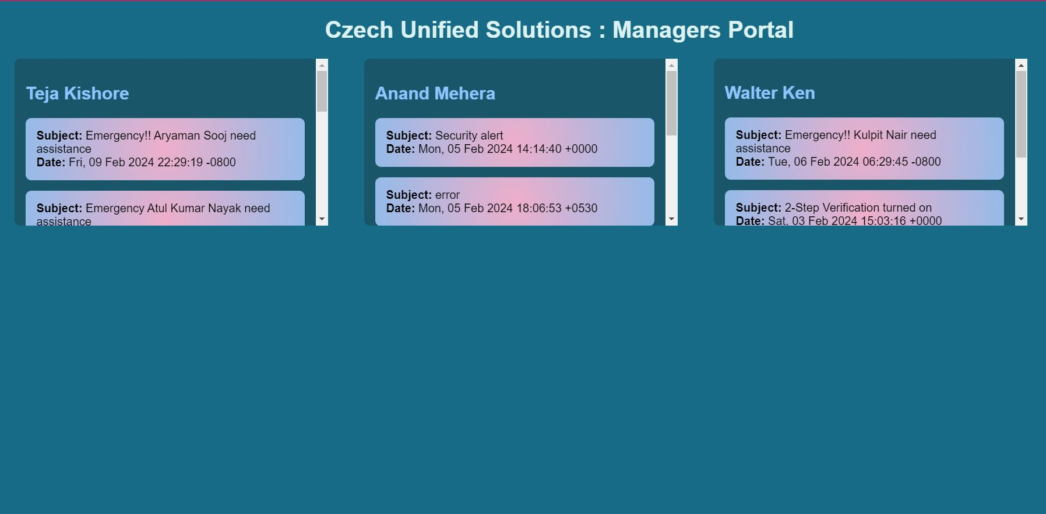
RESULT - Manager Portal

Slide 23
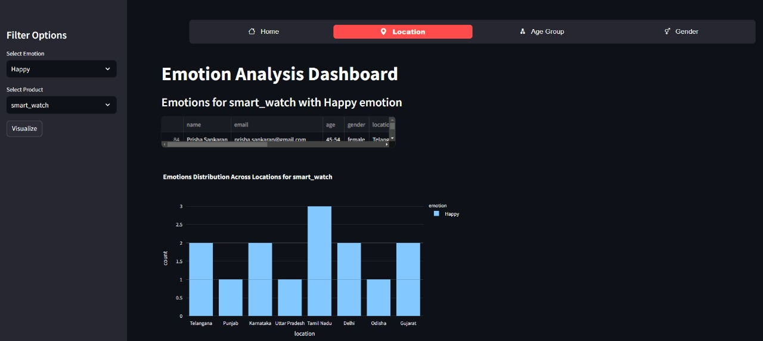
RESULT - Owner Dashboard

Slide 24
FUTURE ENHANCEMENTS
Incorporation of multimodal data
Integration with social media platforms
Multilingual support

Slide 25
CONCLUSION
Emotion is the key to understand the value of any product in this fast paced growing market.
Our project "Emotion recognition from text and feedback analysis using deep learning" helps the owner to analyse the customer emotions very effectively.
This helps the owner of a product to take more effective steps to improve his features resulting in positive customer feedback.

Slide 26
THANK YOU

